Slide 1
Divide and Conquer
Chapter 4
Dr. Maram Bani Younes

Slide 2
Contents
Divide and conquer
Algorithm Max and Min
Maximum Contiguous Subsequence SUM
Binary Search
Quick Sort
Merge Sort
Heap Sort

Slide 3
Divide and Conquer:
(Divide, Conquer, Combine)
The idea is to divide the problem into smaller but similar sub problems (divide),
solve it (conquer),
and (combine) these solutions to create a solution to the original problem.

Slide 4
Problem
Finding the maximum and minimum elements in a set of (n) elements using the straightforward algorithm.

Slide 5
Algorithm: Max and Min
Algorithm straightforward (a, n, max, min)
Input: array (a) with (n) elements
Output: max: max value, min: min value
max = min = a(1)
for i = 2 to n do
begin
if (a(i)>max) then max=a(i)
if (a(i)<min) then min=a(i)
end
end
best= average =worst= 2(n-1) comparisons

Slide 6
Algorithm: Max and Min
If we change the body of the loop as follows:
max=min=a(1)
for i=2 to n do
begin
if (a(i)>max) then max=a(i)
else if (a(i)<min) then min=a(i)
end
best case: elements in increasing order
No. of comparisons = (n-1)
Worst case: elements in decreasing order
No. of comparisons = 2(n-1)
Average case: a(i) is greater than max half the time
No. of comparisons= 3n/2 – 3/2
½ ((n-1)+(2n-2))

Slide 7
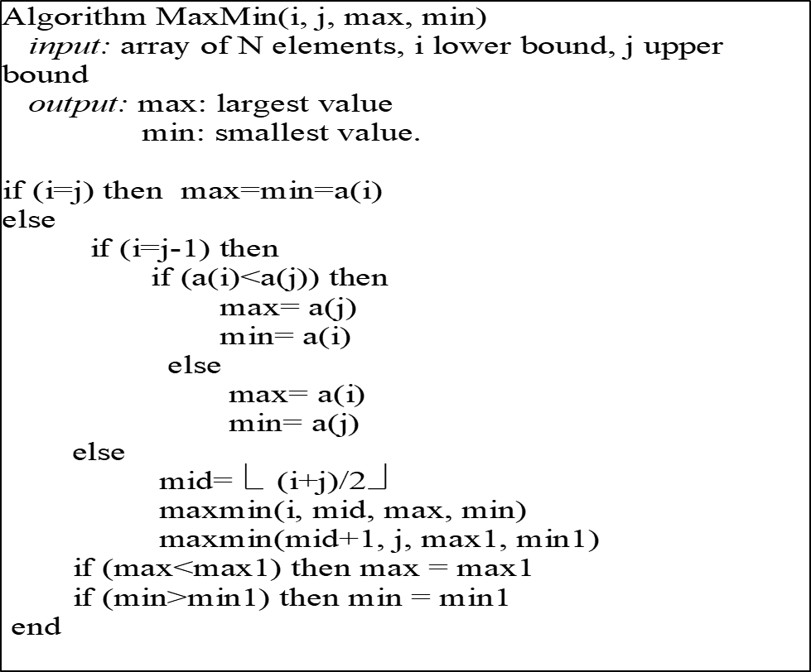
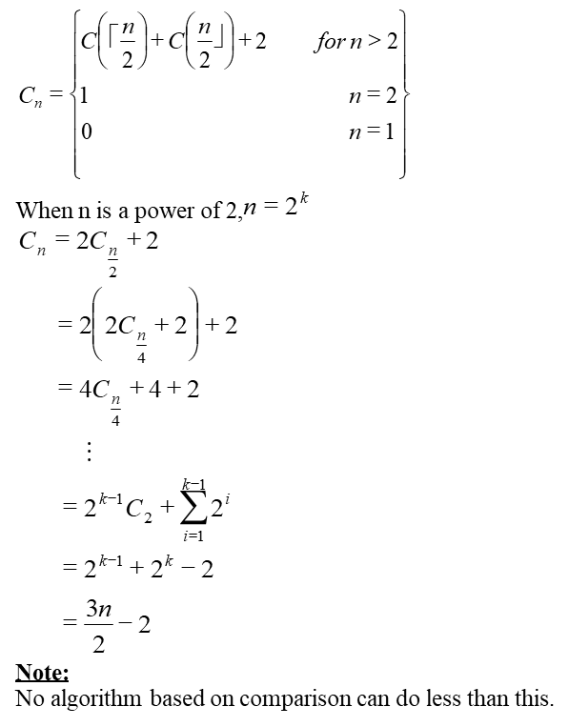
Problem: is to find the maximum and minimum items in a set of (n) elements.

Slide 8
Example
Given a set of n elements. Write an algorithm using divide and conquer, to find the summation of its elements.

Slide 9
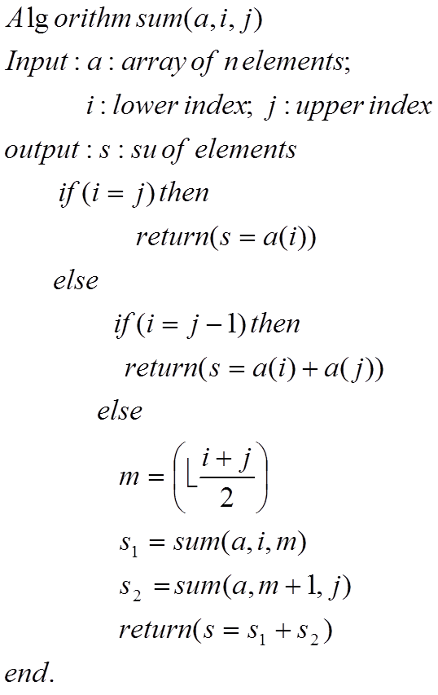
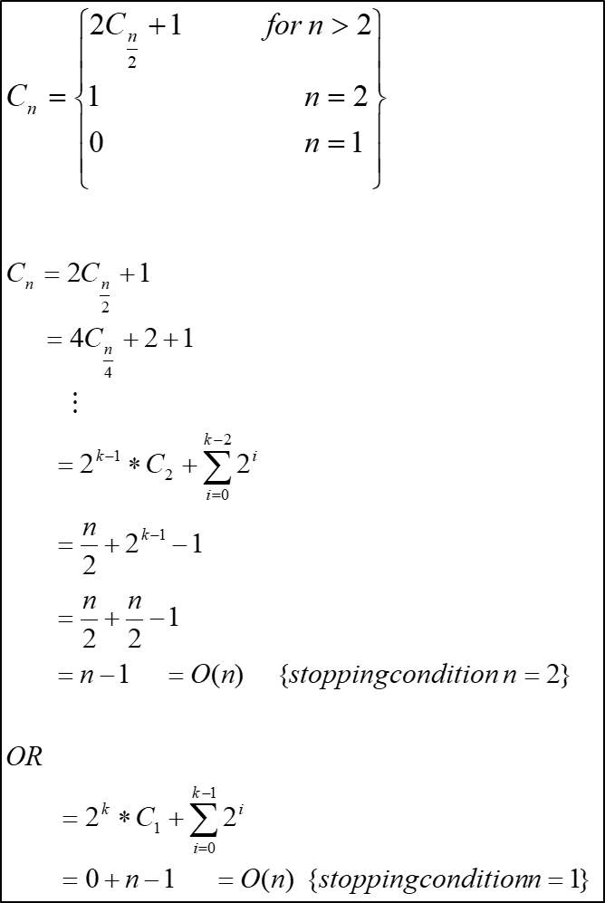

Slide 10
The Maximum Contiguous Subsequence Sum
“Given (possibly negative) integers , find (and identify the sequence corresponding to) the maximum value of . The maximum contiguous subsequence sum is zero if all the integers are negative.”
Suppose we are given the following input
{-2, 11, -4, 13, -5, 2}
The maximum contiguous subsequence sum is (20), which encompassing items 2 through 4.

Slide 11
Divide and Conquer approach
Let consider a divide and conquer algorithm:
We divide the input into two halves. The max contiguous subsequence sum can occur in one of 3 ways:
Case1: It resides entirely in the 1st half.
Case2: It resides entirely in the 2nd half.
Case3: It begins in the 1st half but ends in the 2nd half.
Recursively compute the max contiguous subsequence sum that resides entirely in the 1st half.
Recursively compute the max contiguous subsequence sum that resides entirely in the 2nd half.
Compute via two consecutive loops the max contiguous subsequence sum that begins in the 1st but ends in the 2nd.
Choose the largest of the 3 sums.

Slide 12
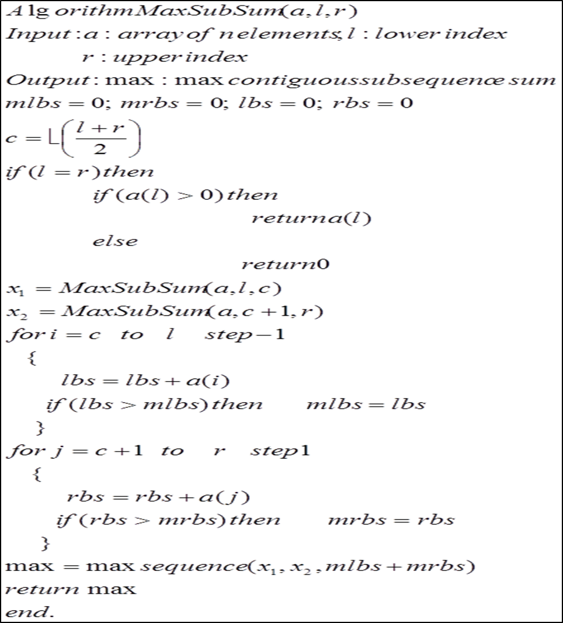

Slide 13
Binary Search

Slide 14
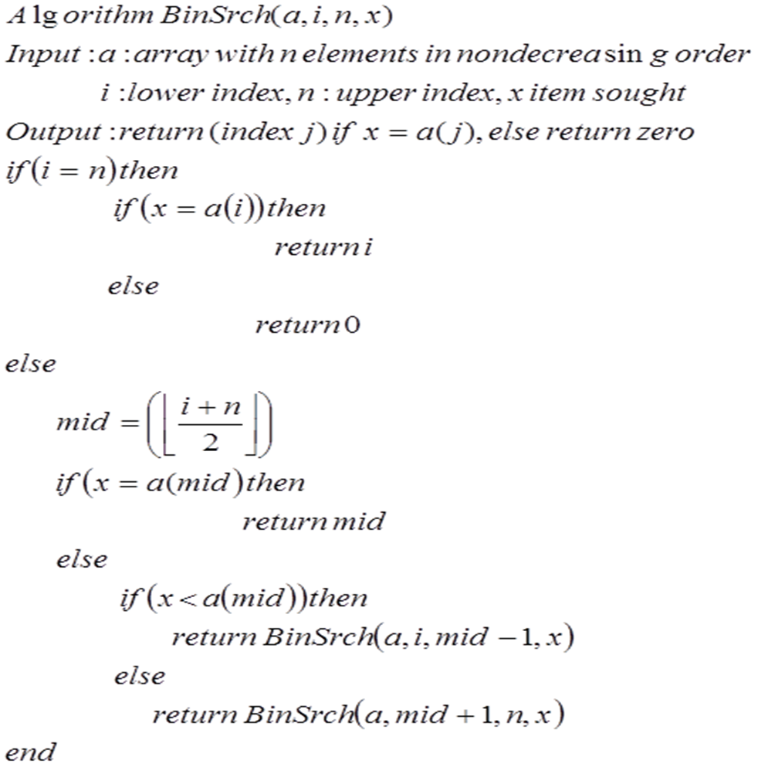
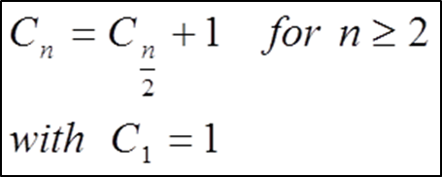

Slide 15
Quick Sort Algorithm
Given the following set of data:
42 23 74 11 65 58 94 36 99 87
1st pass
{11 23 36} 42 {65 58 94 74 99 87}
2nd pass
11 {23 36} 42 {65 58 94 74 99 87}
Last pass
11 23 36 42 58 65 74 87 94 99

Slide 16
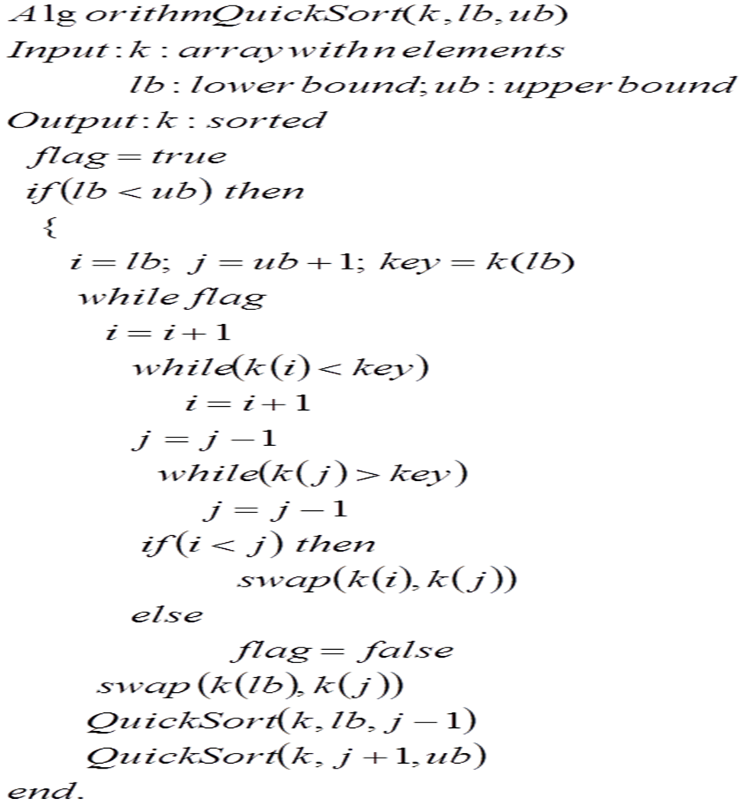
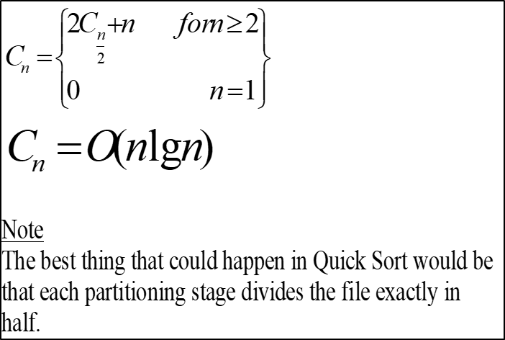

Slide 17
Quick Sort Discussion

Slide 18
Quick Sort Discussion
Although the worst case is still , it is extremely unlikely that we will encounter it.
The probability of encounter the worst case is , where n is the number of elements in the file.
Another method is the median-of-three. We choose the median of the left element, the right element, and the one halfway between them. Unless this median is already the left element, we exchange it with left.

Slide 19
Space Usage
Quick Sort is not working in-place sort. While the algorithm is working on one sublist, the beginning and ending indexes (borders) of all the other sublists must be saved on a stack.
The size of the stack depends on the no. of sublists into which the list will be split.
The worst case amount of space used by stack is .

Slide 20
Merge Sort

Slide 21
Merge Sort

Slide 22
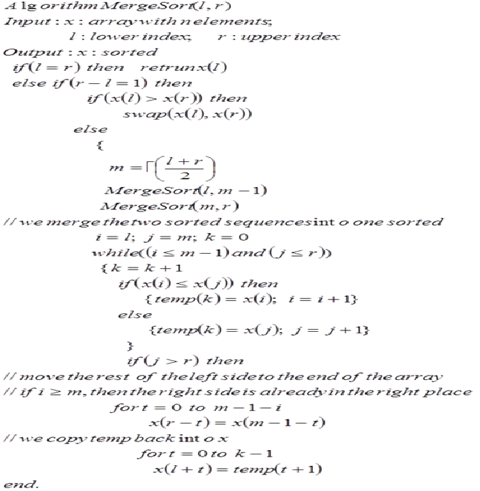

Slide 23
Heap Sort

Slide 24
Heap
Is a data structure that is defined by two properties:
  It is a complete binary tree (implemented using array representation)
  The values stored in a heap are partially ordered. i.e. there is a relationship between the value stored at any node and the values of its children.
(Complete binary trees have all levels except the bottom filled out completely, and the bottom level has all of its nodes filled in from left to right).
Heaps are often used to implement priority queues and for external sorting algorithms.
There are many situations, both in real life and in computing applications, where we wish to choose the next “most important” from a collection of people, tasks, or objects.

Slide 25
Example
19 2 46 16 12 54 64 22 17 66 37 35
Heap⬄ 66 64 54 17 37 35 46 2 16 12 22 19
Sorted⬄ 2 12 16 17 19 22 35 37 46 54 64 66

Slide 26
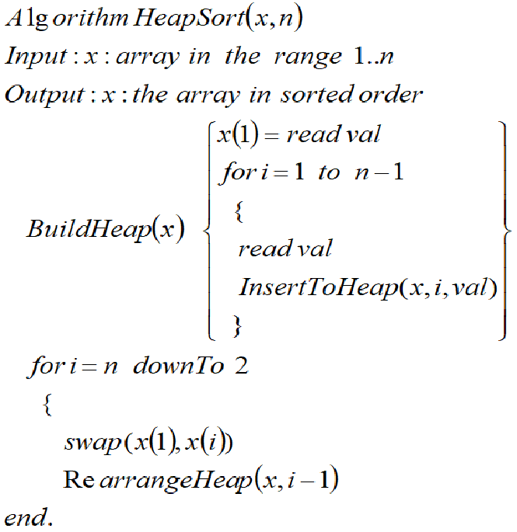
Building a Heap
Example:
Build a Heap for the following set of data:
20,15, 3, 12, 81, 7, 70, 20, 10, 1, 102

Slide 27
Heap Sort

Slide 28
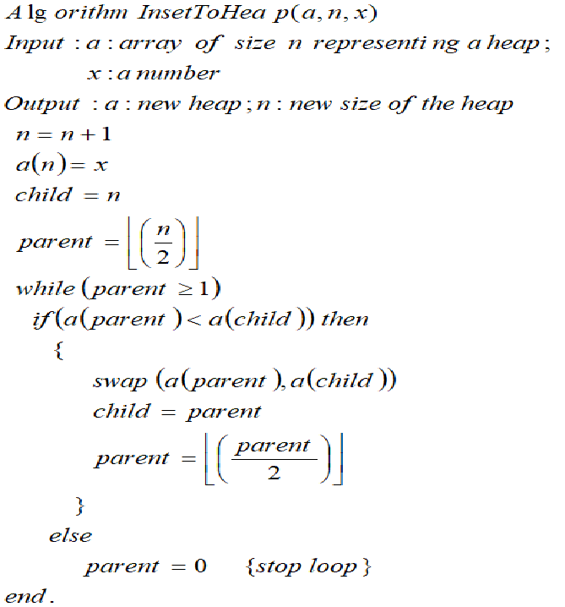

Slide 29
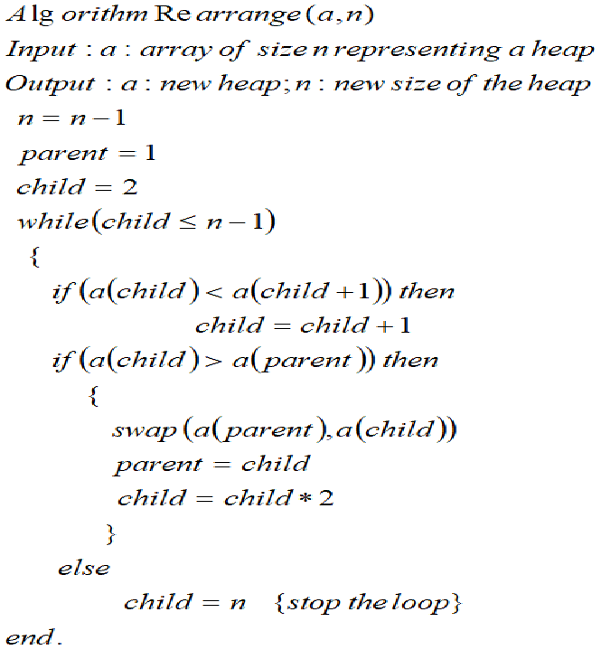

Slide 30
Example
Sort the following characters in a decreasing order using the heap sort, showing the steps of building the heap and then the sorting process:
              COMPLEXITY

